Slide 1
Are data breaches inevitable?

Slide 2
Theoretically - Yes
There is no such thing as an Impenetrable fortress
Given enough time and resources, any security measure can be subverted
According to itgovernance.co.uk, around 41.9 Million records were been breached in just March 2023 https://www.itgovernance.co.uk/blog/list-of-data-breaches-and-cyber-attacks-in-march-2023
Given how the working world has changed, many new security flaws have been introduced
Cloud based work
Working from home - Networks may not be as secure
Access to new devices, everywhere - a compromise could come from any angle
Data is simply becoming a more and more valuable commodity
And old methods work just as well
Phishing remains the tool of choice for hackers
“In 2022, 76% of organizations were targeted by a ransomware attack, out of which 64% were actually infected. Only 50% of these organizations managed to retrieve their data after paying the ransom. Additionally, a little over 66% of respondents reported to have had multiple, isolated infections.” - https://www.forbes.com/sites/chuckbrooks/2023/03/05/cybersecurity-trends--statistics-for-2023-more-treachery-and-risk-ahead-as-attack-surface-and-hacker-capabilities-grow/?sh=6417598819db

Slide 3
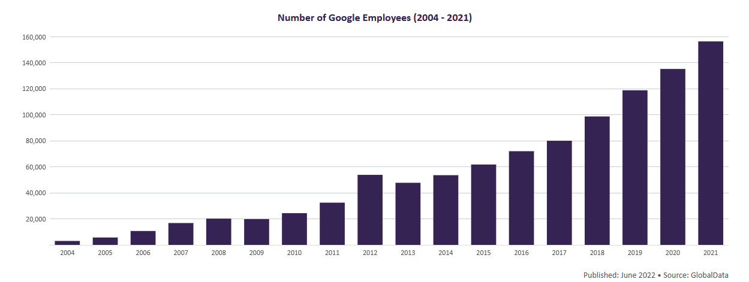
Google breaches
Even the giants within Tech aren’t
safe - Google frequently falls victim to data breaches.
It’s safe to assume that Google’s security measures have increased alongside their employment rate
June – December 2009: Hackers Breach Google Servers
September 2014: Nearly 5 Million Gmail Passwords Leaked Online
September 2015: BrainTest Malware Infects Up to 1 Million Android Devices
November 2016: Gooligan Malware Compromises 1 Million Android Devices
March 2018: Google+ Bug Exposes 500,000 Users’ Data
December 2018: Google+ Bug Exposes 52.5 Million Users’ Data
January 2023: Google Fi Customer Data Stolen in T-Mobile Breach
Information taken from: https://firewalltimes.com/google-data-breach-timeline/

Slide 4
If breaches are inevitable, then should third parties be trusted with our data?
The reality is that we are now in a world where our actions, lives and patterns are logged
Of course, some of this is necessary or acceptable
Government bodies need our data for records
Companies keep our data for our convenience
Once our data is in the hands of another, it should be their responsibility to look after it
Equally, we have to accept that our data being leaked is a risk that comes with living in the modern world
However, If breaches are indeed inevitable, then perhaps the most important thing that can be done is to limit what data can leaked

Slide 5
What can be done?
Treat data breaches as inevitable
Anonymise data
“Need to know” basis
“Never trust, always verify” - Microsoft Zero Trust
Only gather what you need
Use AI or Machine Learning to help secure data
These tools can be used to help protect against conventional/emerging forms of cyber-attacks, or recognise patterns associated with breaches earlier than before
However, our tool is another's weapon - these same tools can be used to enable breaches in the same way

